Slide 1
UGP: ENERGY TRANSITION MODELING USING GAMS
AYUSHI MEHTA
220275

Slide 2
INDIA’S SCENARIO
India is on the path to diversify its energy sources towards green alternatives, which is consistent with the global call to curb carbon emissions.
The shift is from coal to renewable energy(specifically solar and wind energy) in electricity generation.
The electricity generated from renewable sources is projected to increase from 18% in 2019 to 50-70% by 2040.
Following similar footprints, the main aim of our UGP was to build an energy transition model to reduce the dependency of the campus on grid electricity and instead shift to renewable sources like Solar energy, Wind energy and also Battery for storage purposes.

Slide 3
PATH TAKEN FORWARD
Earlier while shifting from coal to renewable sources of energy, sources like Solar power were considered without taking into account the need for storage of energy.
Usage of Solar power alone without the use of Battery as a storage device has many disadvantages which include:
Intermittency: Solar power generation is intermittent, depending on weather conditions and daylight hours.
Grid Stability: Solar power's variability can destabilize the grid, especially during sudden fluctuations in generation.
Mismatched Demand and Supply: Excess energy generated during the day may go to waste, while insufficient energy may be available during peak demand times.
Economic Viability: The economics of solar power without storage may be less favorable, as utilities may incur additional costs to manage intermittency and grid stability issues.

Slide 4
Thus, to overcome these problems slowly people have started using Battery along with Solar power and are trying to replace coal by these sources.
My energy transition model is built on similar grounds.
The model is basically an optimization problem.
To solve this optimization problem in a realistic way, our goal should be to minimize both overall cost as well as carbon footprints as a result of the transition taking place.
First of all, we work on this problem using only a single optimization function where our goal is to minimize the overall cost involved in the process.

Slide 5
GAMS
In order to solve this optimization problem, I have used the GAMS (The General Algebraic Modeling System) software as my tool.
GAMS is a high level modeling system for mathematical programming and optimization, and it consists of a language compiler and a range of associated solvers, such as Cplex, Scip, etc. Based on these solvers and their options, the above model can be solved.
The above model belongs to a MINLP(Mixed-integer nonlinear programming) problem.

Slide 6
GAMS ELEMENTS
Each GAMS model consists of the following main elements:
Sets: Sets are used to define the indices in the algebraic representations of models. For example, set of generating units, set of network buses, set of slack buses, set of time periods, etc.
Data: The input data of each GAMS model are expressed in the form of Parameters, Tables, or Scalars. The parameters and tables are defined over the sets. The scalars are single value quantities.
Variables: The variables are decision sets and are unknown before solving the model.
Equations: The equations describe the relations between the data and variables.
Model and Solve Statements: The model is defined as a set of equations which contain an objective function. The solve statement asks GAMS to solve the model.
Output: There are several ways to see the outputs of the solved model such as saving them in XLS file and displaying them.

Slide 7
WORKING PRINCIPLE OF GAMS
A general overview of the working principle of GAMS:
Model Formulation: The first step in using GAMS is to formulate your optimization problem as a mathematical model. This involves defining decision variables, objective functions, and constraints. GAMS provides a modeling language that allows you to express mathematical relationships and optimization objectives in a concise and intuitive way.
GAMS Model File: Once you have formulated your model, you write it in a GAMS model file (with a .gms extension). This file contains the mathematical representation of your optimization problem using GAMS syntax.
Execution: To solve the model, you use the GAMS system to execute the model file. GAMS reads the model file, parses the syntax, and prepares the problem for solution.

Slide 8
4.Solver Integration: GAMS itself does not solve optimization problems directly. Instead, it acts as a modeling language and an interface to various solvers. When you run the GAMS model, it interfaces with the specified solver or solvers to find solutions to the optimization problem.
Solver Interaction: The solver receives the optimization model from GAMS, performs calculations to find optimal solutions, and communicates the results back to GAMS.
Solution Output: GAMS can display and save the results of the optimization, including the optimal values of decision variables, the objective function value, and any other relevant information. This allows users to analyze and interpret the solution.

Slide 9
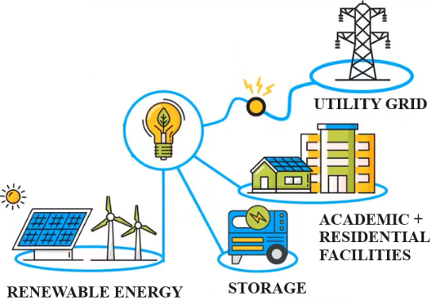
PROBLEM STATEMENT
System description:
IIT Kanpur campus has a main grid supplying electricity to the whole campus. Along with it Solar power plants are installed and Battery is available for storage.
Objective:
Our objective is to minimize the operation and capital costs (overall costs) in generating electricity as per the RESCO model.

Slide 10
Assumptions :
The operating cost is zero.
The considered powers are the average value in each time slot (1 h) = operating step
The time horizon is one month (24 hours × 31 days)
End Goal:
Optimum capacity of Solar and Battery so that overall cost of electricity generation is minimized.

Slide 11
INPUTS IN OUR MODEL
Load data of the campus.
Solar energy generation data.
Fixed cost of energy from grid= Rs 3150000 for a month
Variable cost of energy from grid= 8.5 Rs per unit
Variable cost of Solar energy = 3.20 Rs per unit
Variable cost of Storage = 10.18 Rs per unit
Sanctioned load for campus= 10.5 MW

Slide 12
OBJECTIVE FUNCTION
Minimizing total cost including grid cost, cost of solar energy, cost from battery.

Slide 13

CONSTRAINTS IN OUR MODEL
Power balance equation
Charging/Discharging constraint of battery
Ramp up/Ramp down constraints

Slide 14
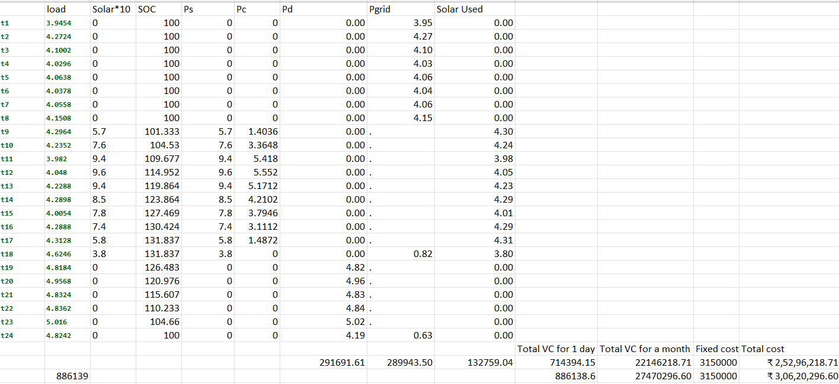
OUTPUTS/END RESULTS
Taking maximum capacity of Solar plant to be 10 MW

Slide 15
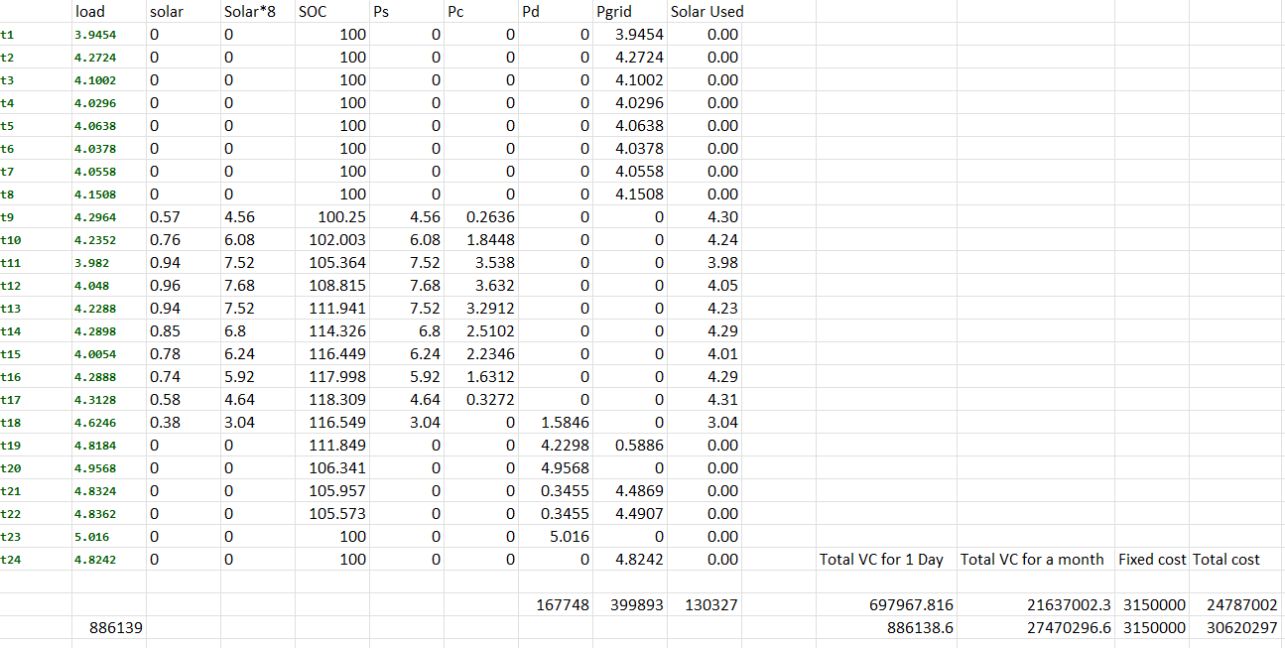
Taking maximum capacity of Solar plant to be 8 MW

Slide 16
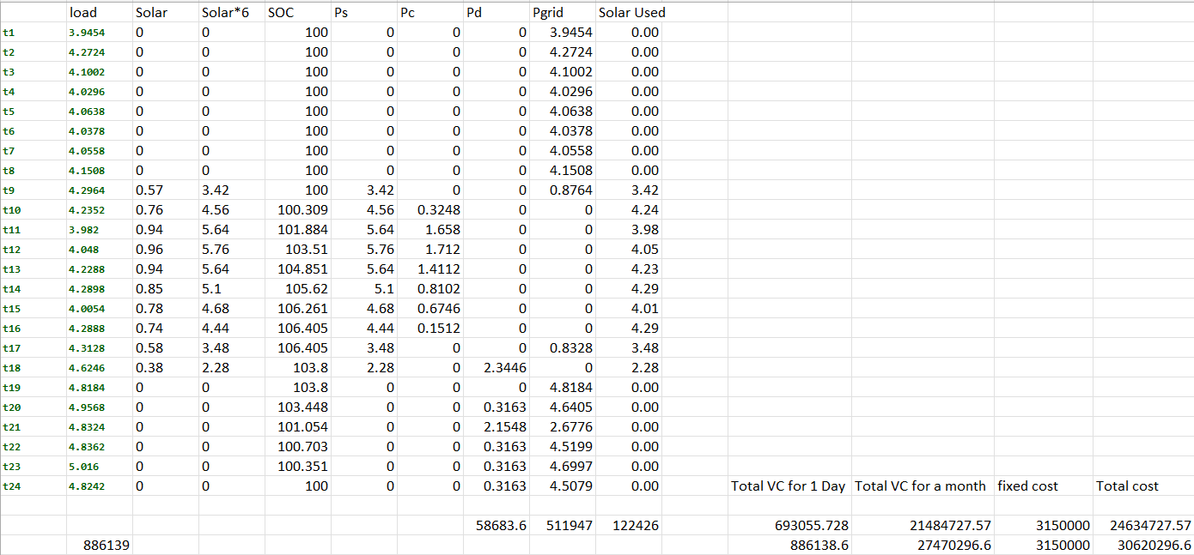
Taking maximum capacity of Solar plant to be 6 MW

Slide 17
DISADVANTAGES
This model also comes with several disadvantages which include:
Cost: Battery storage systems are very expensive to install and maintain.
Efficiency Losses: Energy stored in batteries can incur efficiency losses during the charging and discharging process.
Limited Lifespan: Batteries have a limited lifespan. Over time, the storage capacity of batteries degrades, requiring replacement. This adds to the long-term costs

Slide 18
OTHER SOURCES OF STORAGE
Pumped Hydro Storage: Pumped hydro storage is one of the oldest and most established forms of grid energy storage. It involves pumping water to a higher elevation reservoir during times of excess energy and releasing it through turbines to generate electricity when demand is high.
Compressed Air Energy Storage (CAES): CAES systems store energy by compressing air into underground caverns or tanks during times of low demand. When energy is needed, the compressed air is released and expanded through turbines to generate electricity.
Others include Thermal Energy Storage(TES) , Hydrogen Energy Storage, etc.

Slide 19
MULTI OBJECTIVE OPTIMIZATION
A potential area to work on is considering two objective functions instead of one and minimizing both overall cost as well as carbon footprints.
Problems that have more than one objective function are referred to as multi-objective optimization (MOO) problems.
There are several methods by which MOO’s can be solved and it is a good area of research to explore the best method that can be used.
Reference research paper: https://www.tandfonline.com/doi/full/10.1080/23311916.2018.1502242

Slide 20
MOO PROBLEMS
The various types of MOO problems are followed by many settlement methods as well which include the global criterion method, weighted-sum method, ε-constraint method, lexicographic method, goal programming, Multi-objective evolutionary algorithm (MOEA), etc.
Some of the MOO settlement methods show that a complex method of solving and difficult mathematical equations are used.
But there are others which do not require complex mathematical equations in order to simplify the problem namely the Pareto method and Scalarization.

Slide 21
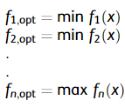
PARETO METHOD
The Pareto method is used if the desired solutions and performance indicators are separate and produce a compromise solution (tradeoff) and can be displayed in the form of Pareto optimal front (POF).
Mathematically, the MOO problem using the Pareto method can be written as follows :

Slide 22
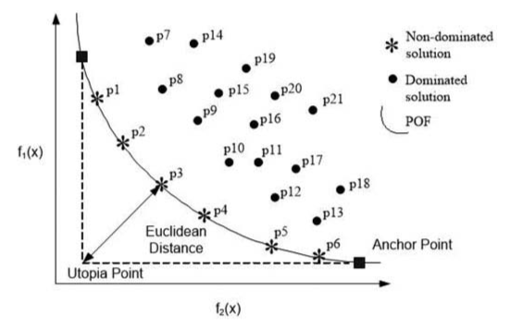
REPRESENTING PARETO OPTIMAL FRONT
The optimization with two objective functions and the non-dominated solution can be described in a POF on a two-dimensional surface. For example, the objective function is to minimize the objective functions of . The non-dominated solution (p1, p2, p3, p4,p5, and p6) and dominated solution (p7, p8, ..., p21) can be seen in the figure.

Slide 23
SCALARIZATION METHOD
The scalarization method makes the multi-objective function create a single solution and the weight is determined before the optimization process. The scalarization method incorporates multi-objective functions into scalar fitness function as in the following equation:

Slide 24
CONCLUSION
Transition from coal to renewable sources is not easy, all methods have their own disadvantages.
The way forward can be to research about possible ways to minimize these disadvantages.
Also we can work on a model incorporating multi-objective functions so that we can optimize both cost and carbon footprints.

Slide 25
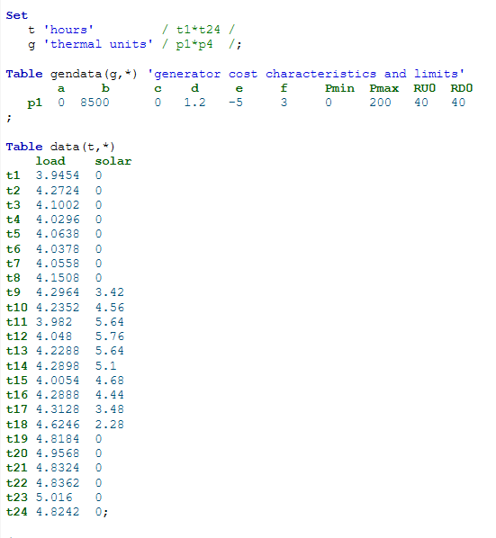
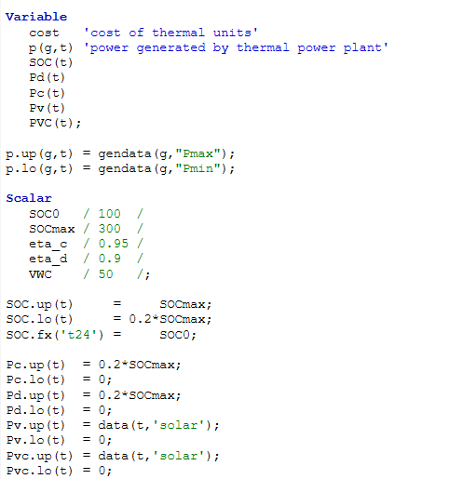
MODEL

Slide 26
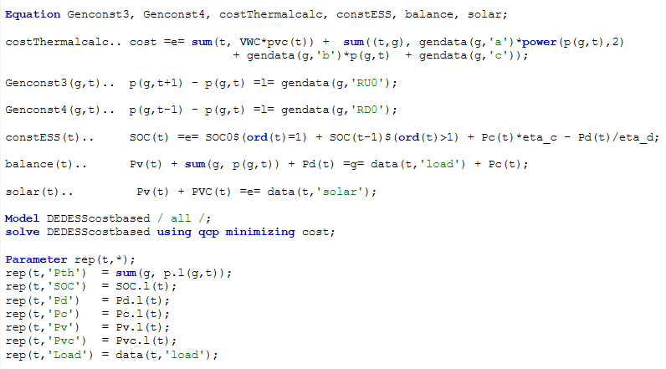

Slide 27
THANK YOU

